Slide 1






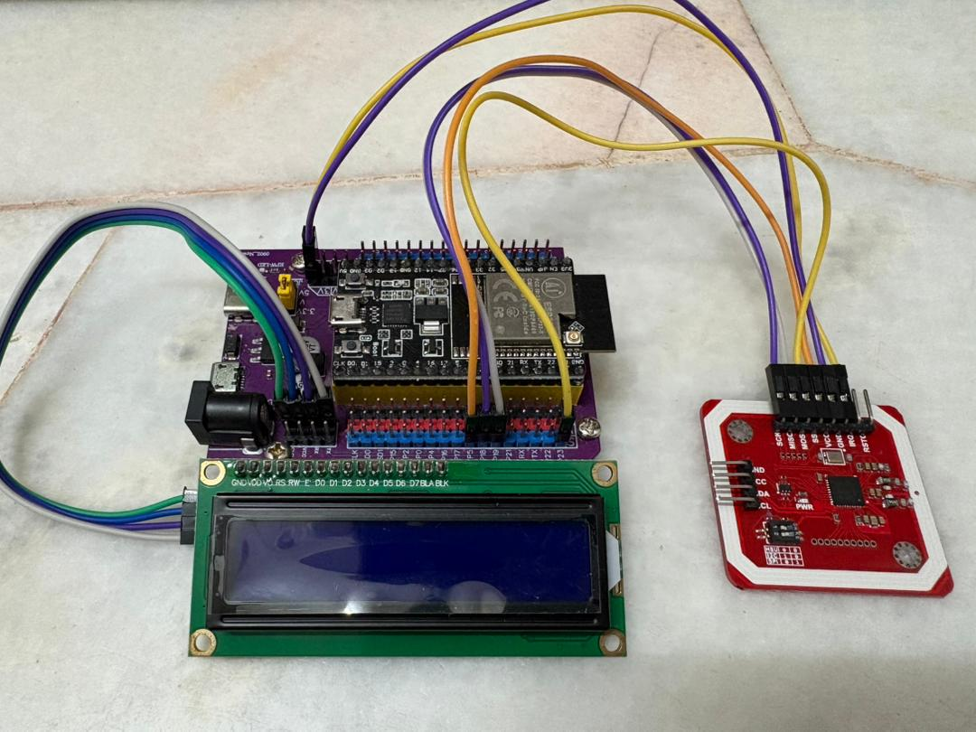
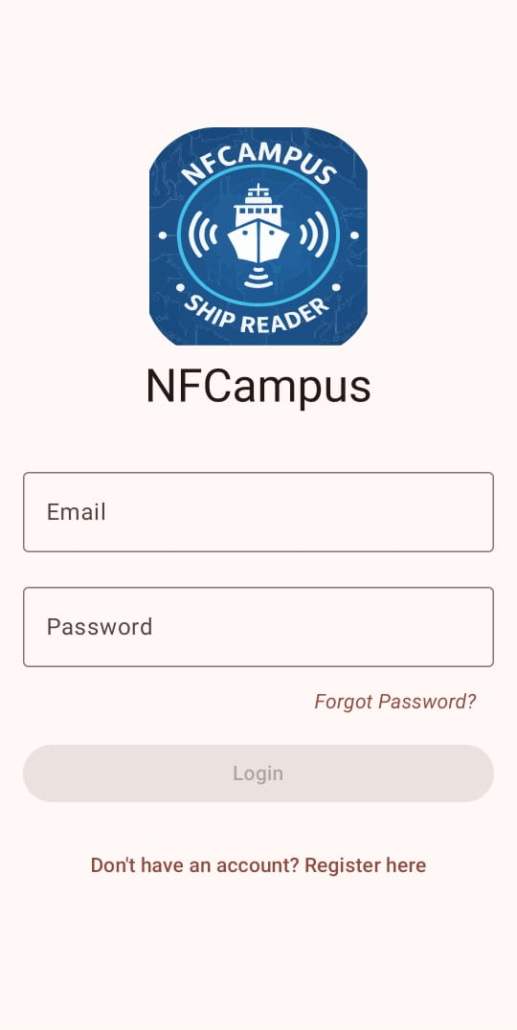
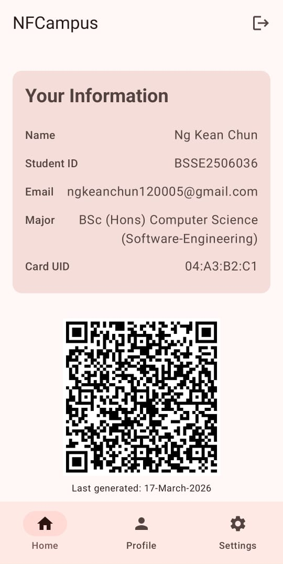
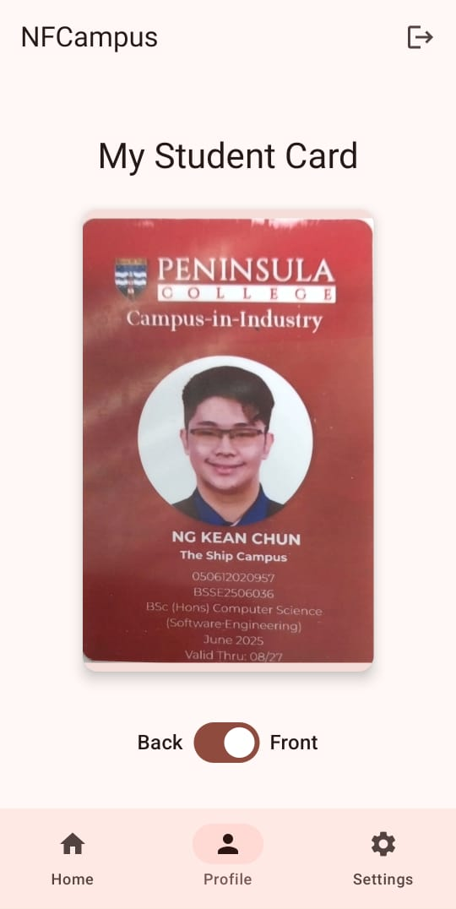












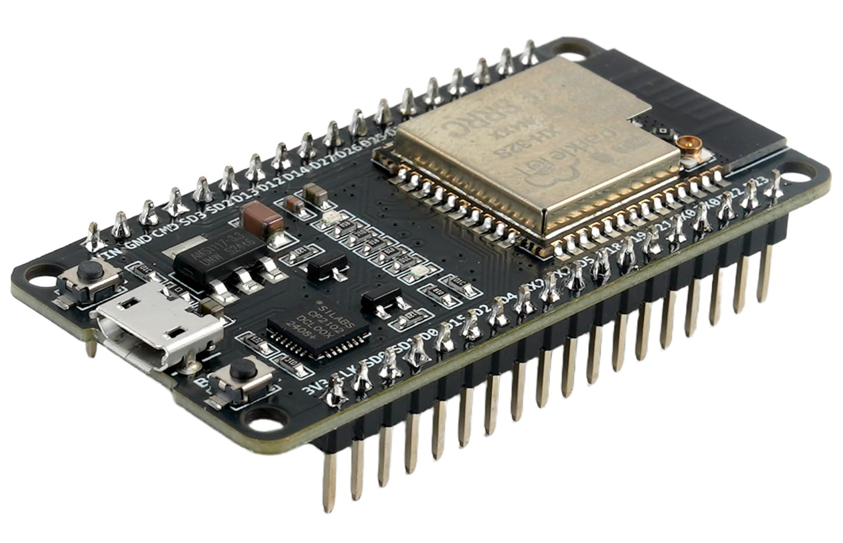
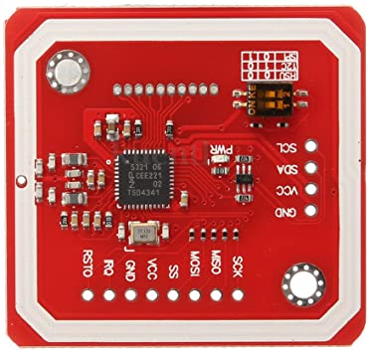













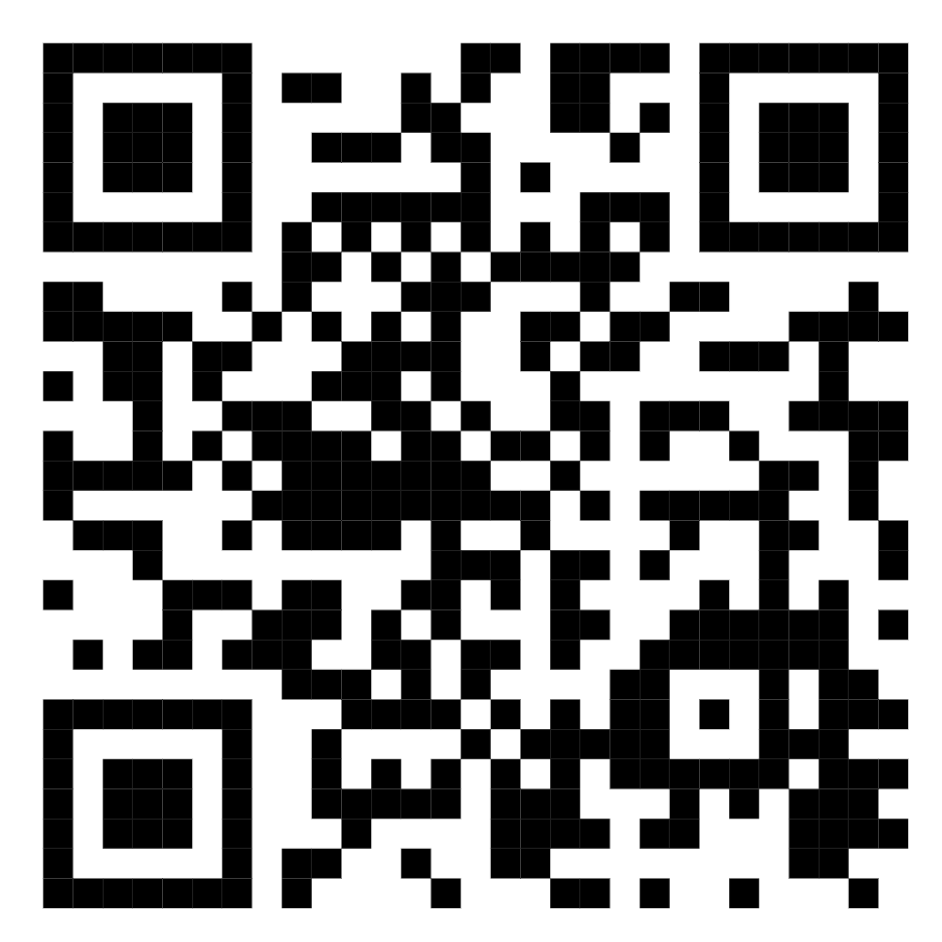
NFCAMPUS
A DIGITAL STUDENT IDENTIFICATION & ACCESS SYSTEM USING NFC TECHNOLOGY FOR ANDROID
Eu Jin Yang jin.eu@students.plymouth.ac.uk
Ng Kean Chun kean.c.ng@students.plymouth.ac.uk
Teoh Yi Shan yi.teoh@students.plymouth.ac.uk
Yong Ken ken.yong@students.plymouth.ac.uk
BACKGROUND & PROBLEM STATEMENT
IMPLEMENTATION PLAN
METHODOLOGY
Our college uses RFID access cards for entry into campus buildings, libraries, and labs.
Module 1: Basic Foundations
Develop a backend server, database, and basic API endpoints
Build an Android app with a login system, user interface and navigation
Framework:
Agile-Scrum approach with iterative development
PROBLEM
SOLUTION
Sprints
Two-week development cycles
Module 2: Core Features
OCR registration flow, NFC UID capture
Password and email login, one-card-per-account system
Sprint Planning
Persistent project tracking
VS
Daily Stand-ups
Synchronize activities and identify blockers
While effective, this system has a major flaw: “It relies solely on a physical card”.
Students are frequently locked out due to forgotten, lost, or damaged cards
Leading to missed classes, exams, and significant frustration.
The core issue is that the system identifies the card, not the person.
Our solution leverages NFC technology on smartphones
Creating a digital credential that integrates access control into a device students always carry.
Module 3: HCE Integration
Implement HCE service to emulate card’s UID
Integrate “Simulate Access” feature
Sprint Review
Demonstrate completed functionality
Module 4: Testing & Polishing
End-to-end testing, security auditing
User testing, documentation
Retrospective
Process improvement and refinement
OBJECTIVES
Develop a secure and reliable smartphone-based authentication system that supplements the existing college access card system.
SYSTEM’S GUI EXAMPLE
SMART Criteria:
ESP32 with Expansion Board
Specific
Develop a functional mobile application prototype that can emulate the college access card’s credentials through NFC
PN532 (SPI)
Measurable
Prototype should successfully interact with test reader and trigger the “unlock” signal
Achievable
Use Android Studio and Host Card Emulation (HCE) for Android phones
Relevant
Provides a practical, modern supplement to the existing card system
LCD Display (I2C)
Time-Bound
Project deadline: 28th March 2026
HOW THE SYSTEM WORKS
KEY FEATURES
Receive & Store UID
User Authentication: Email and password login system
OCR Integration: Automatic card scanning
NFC UID Binding:
Secure card-to-account linking
Student Card
Phone acts as HCE
HCE Technology: Smartphone card emulation
Cloud Backend: Firebase-powered data management
Secure Storage: Encrypted credential protection
Student
NFCampus
Login Screen
Home Screen
Profile Screen
Send Application Data
Receive Application Data
Send UID as Application Data via APDU
WHY NFCAMPUS
EXPECTED OUTCOME & SIGNIFICANCE
Convenience:
Students always carry smartphones
Safe Testing:
Uses a custom NFC reader prototype
Security:
Encrypted NFC authentication
ESP32
PN532
Anticipated Results:
A fully functional Android application
Seamless NFC-based access control
Enhanced security model
Contributions:
Academic: Advancement in mobile computing and security
Industrial: Modernization of campus infrastructure
Societal: Enhanced user convenience and inclusivity
Beneficiaries: Students and the academic institution
Reliable Backup Access: Works alongside existing campus cards
Future-Ready:
Supports smarter campus access systems
Validates Application Data (UID) Against Its Stored Whitelist
Access Granted
Android
Studio
Firebase
Cloud
Firestore
Kotlin
Node.js
Javascript
GitHub
Figma
SCAN HERE FOR REFRENCES

